Slide 1
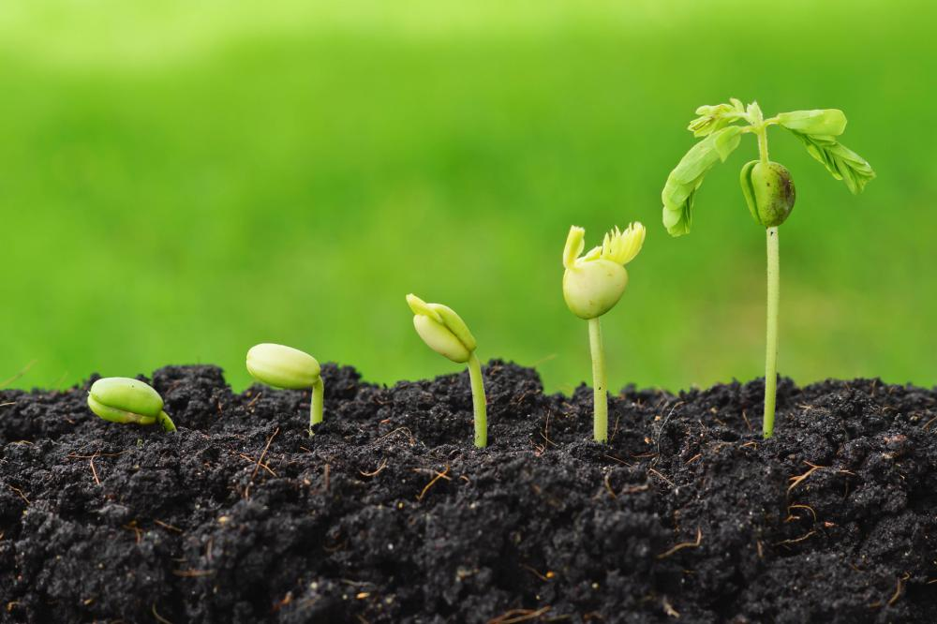
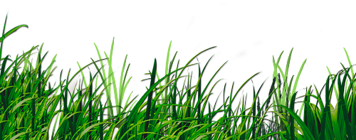
BRIEF HISTORY OF
AGRICULTURE
Pauline rode
Arthur jaccard
https://www.euromontana.org/

Slide 2
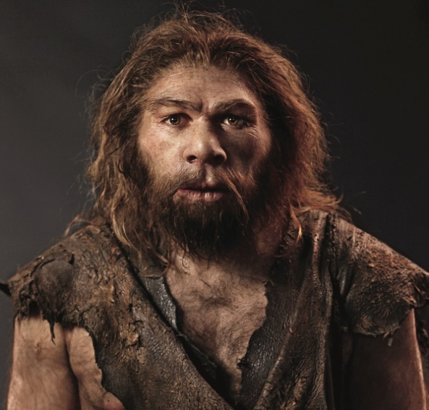
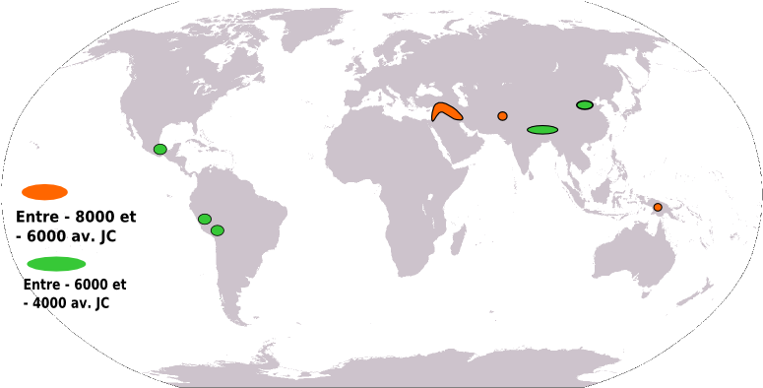
Introduction
https://www.thinglink.com/scene/975357893584879618
Definition of agriculture
Harvesting, fishing, hunting
Homosapiens
6 centers of agriculture in Neolithic
http://fracademic.com/dic.nsf/frwiki/780922

Slide 3
Plan
- Introduction
1- Neolithic revolution
2- Roman agriculture
3- Middles ages
4- From Renaissance to industrial revolution
- Conclusion

Slide 4
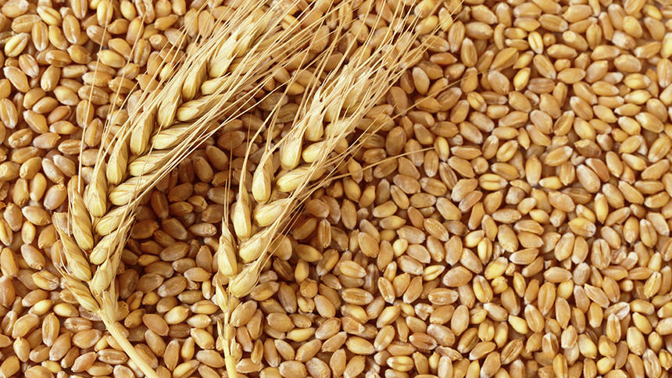
Neolithic revolution
Crops
Domestication of crops
Wind energy, hydraulic energy, solar energy…
Wheat, sorghum, rice, fig
Optimal climat

Slide 5
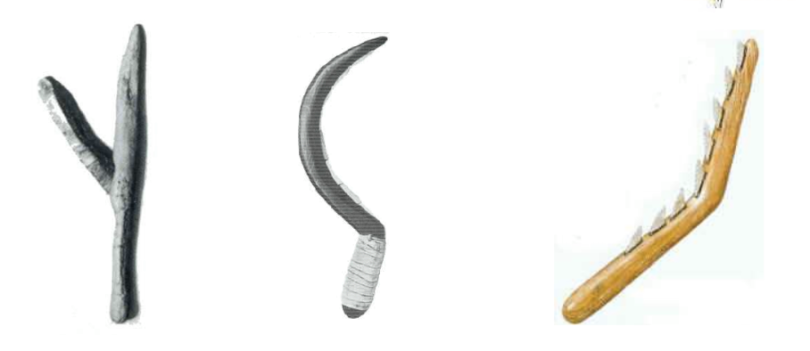
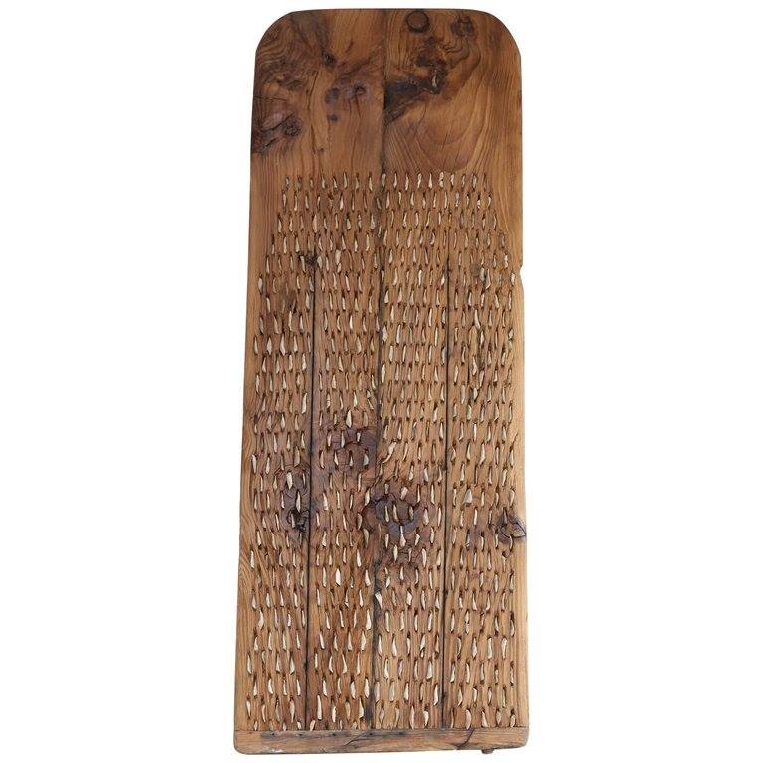
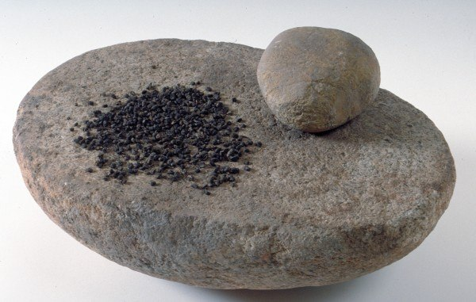
Tools
https://a.1stdibscdn.com/
http://musee-fenaille.rodezagglo.fr/oeuvre/meule-et-grains-de-ble-2/

Slide 6
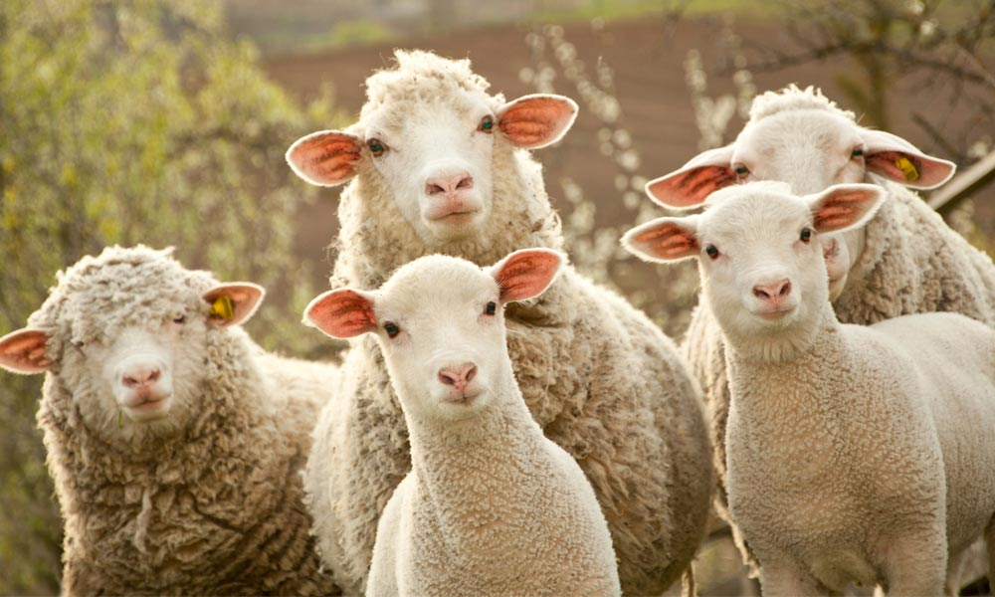
B) Livestock
First domesticated animals : sheeps, pigs
Primary food and accessories
http://www.animalsaustralia.org/issues/secret-lives-of-sheep.php

Slide 7
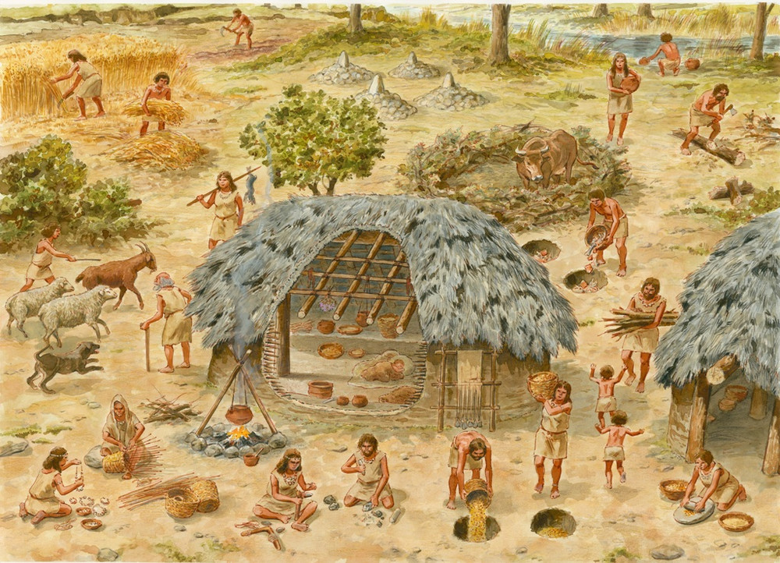
c) Consequences
Better conditions than before
From nomadic to sedentary
first communities
http://theodore-despeyrous.entmip.fr/espace-pedagogique/histoire-geographie-education-civique/6e/la-quot-revolution-quot-neolithique-14251.htm

Slide 8
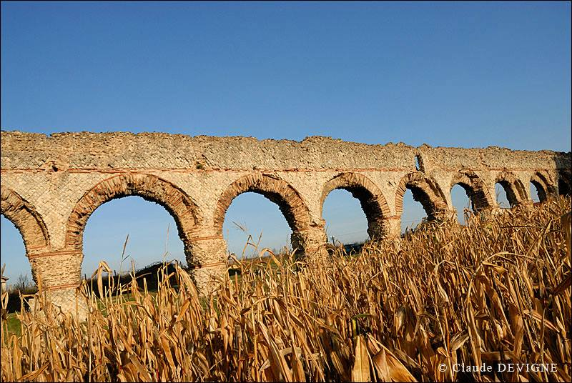
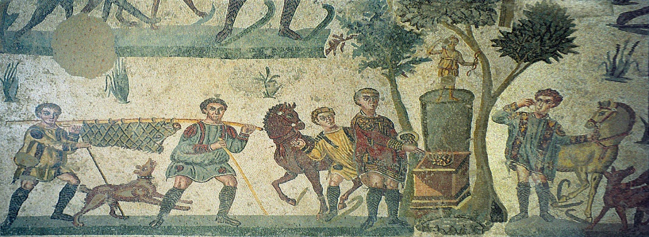
Roman agriculture
Crops
Grains, olives and grapes
Mustards, aromatical herbs, figs…
New sophisticated tools ( irrigation)
http://www.patrimoine-lyon.org/colline-de-fourviere/saint-irenee/les-aqueducs
https://en.wikipedia.org/wiki/Ancient_Roman_cuisine

Slide 9
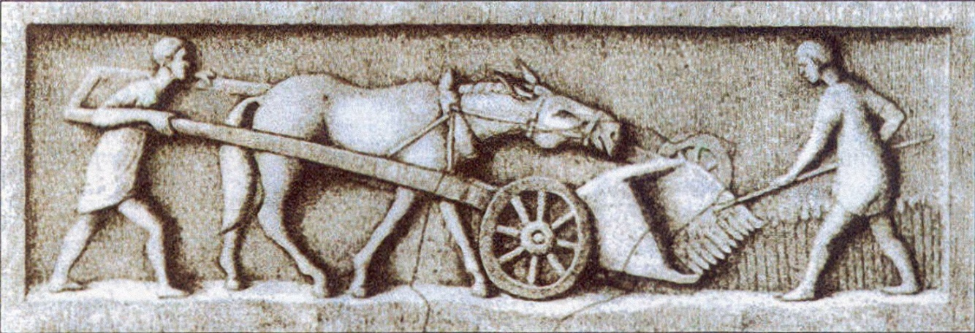
b) Livestock
Important place in the society
One animal → one utility
https://en.wikipedia.org/wiki/Roman_agriculture

Slide 10
c) Consequences
Distinction between rich and poor people
Rising of commerces
Impact on economy and size of farm

Slide 11
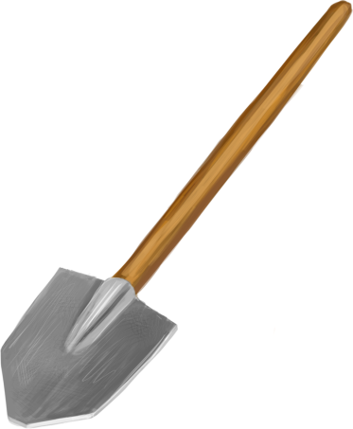
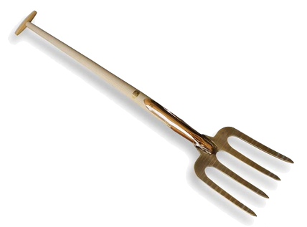
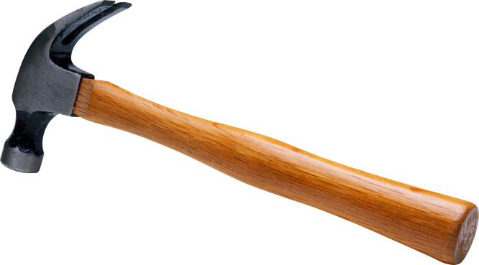
Agriculture in Middle age
Crops
Fields and orchards
Tools: Shovels, forks, hammers…
http://pngimg.com/imgs/technic/hammer/
http://pngimg.com/imgs/technic/shovel/
https://www.gardenista.com/posts/best-tools-10-favorite-garden-digging-forks/

Slide 12
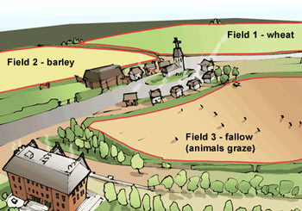
Crop rotation
New way of thinking
3 Different fields
Circle on 3 years
fallow is essential
https://www.thinglink.com/scene/459450321295376385

Slide 13
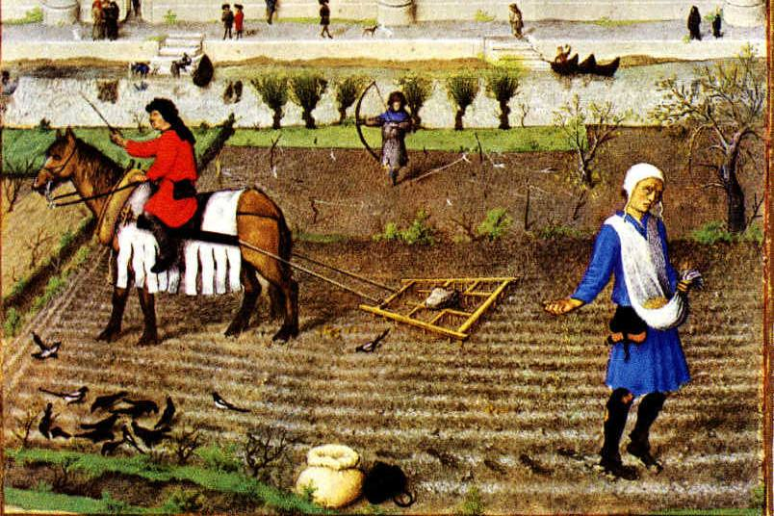
b) Livestock
Animals were tools
Easier to feed the animals
Dogs to keep the herds
Excrement helped the crops agriculture
http://www.allotment-garden.org/crop-rotation/history-principles-crop-rotation/

Slide 14
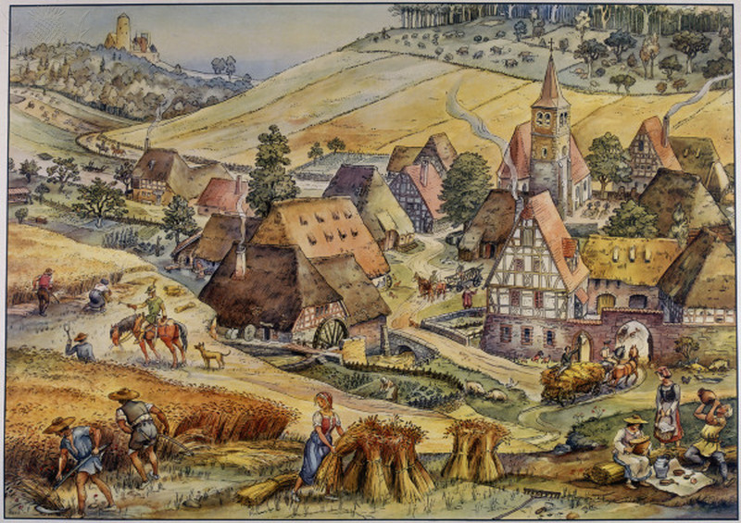
C) Consequences
- Crucial for the economy
https://johnwhye.com/2015/10/14/castles-of-europe-part-2/

Slide 15
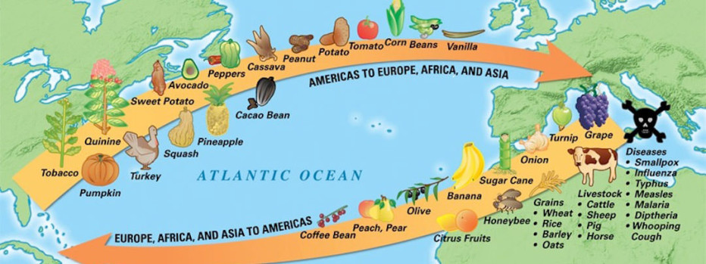
From Renaissance to
Industrial revolution
Crops
- Example: Chocolate in Switzerland
- The beginning of the exchange
- Columbian exchange
https://learnodo-newtonic.com/columbian-exchange-facts

Slide 16
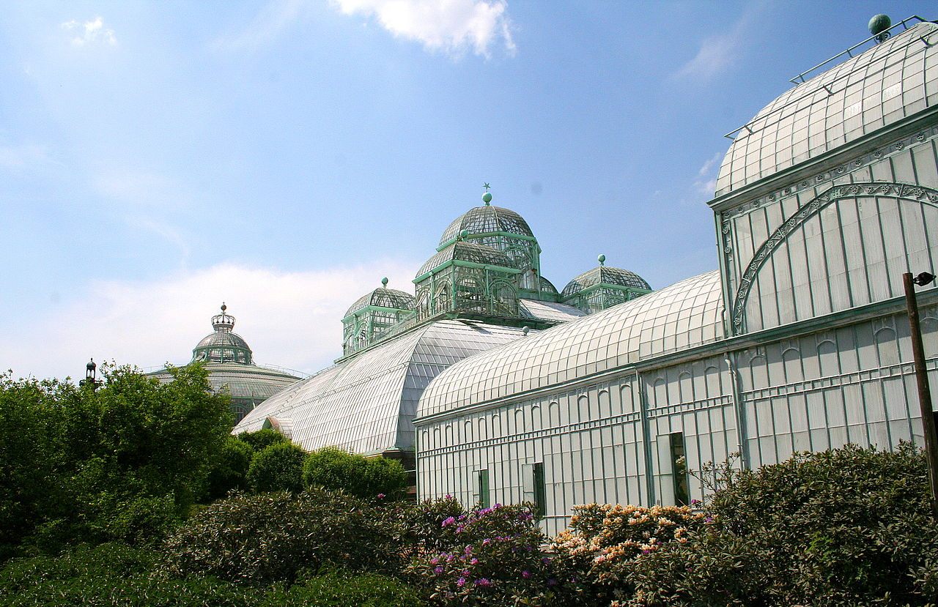
Glass houses
Transparent glass
Extend time to grow
Protect from weather
https://fr.wikipedia.org/wiki/Serre

Slide 17
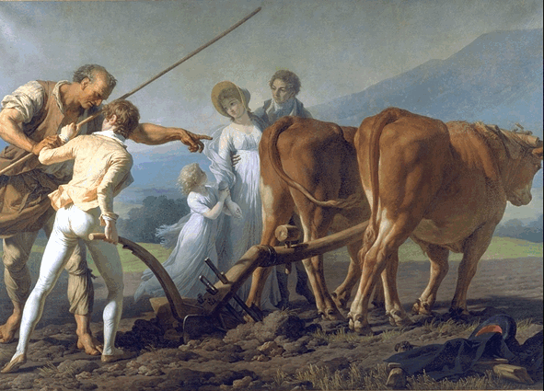
b) Livestock
Exchanges
Examples: horses and chicken in America
http://www.culture.gouv.fr/cgi-bin/chronologique-eng?args,Vincent,Lacour,David,

Slide 18
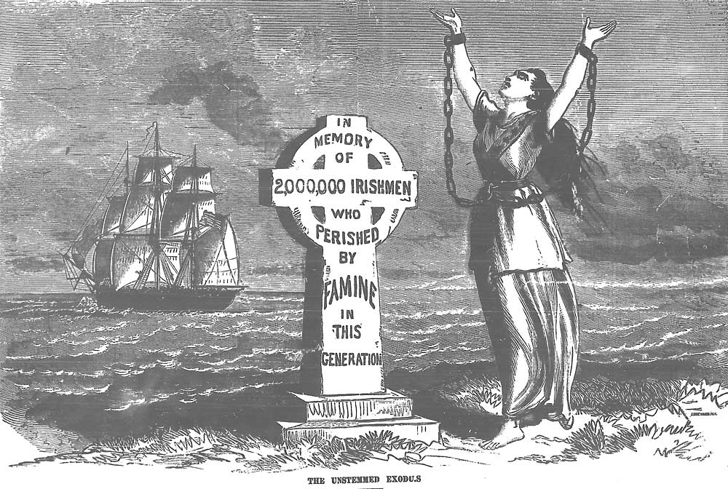
c) Consequences
Monoculture
Irish famine caused by mildew
A lot of death
http://celticthoughts.com/ireland-and-sins-of-the-irish-famine/

Slide 19
Bibliography
https://en.wikipedia.org/wiki/History_of_agriculture
https://www.ancient.eu/Fertile_Crescent/
http://www.newworldencyclopedia.org/entry/History_of_agriculture
https://en.wikipedia.org/wiki/Roman_agriculture
http://www.lordsandladies.org/farming-middle-ages.htm
http://www.oxfordscholarship.com/view/10.1093/acprof:oso/
http://www.flowofhistory.com/units/west/10/FC63
http://www.encyclopedias3.com/encyclopedia-of-food-and-culture-volume-1/18061-from-renaissance-to-agricultural-revolution.html
https://www.theguardian.com/inequality/2017/dec/05/how-neolithic-farming-sowed-the-seeds-of-modern-inequality-10000-years-ago
VIDEO :
https://www.youtube.com/watch?v=7t04_FGBtSA

Slide 20
Thank you for your attention
Do you have any questions?

